Slide 1


PREDICTIVE ANALYSIS OF BLACK FRIDAY
DATA MINING

Slide 2




CONTENT
DATA WRANGLING
INTRODUCTION
2
1
RANDOM FOREST
3
LINEAR REGRESSION
4
GRADIENT BOOSTING
5
DECISION TREE
6
CONCLUSION
7

Slide 3

PROBLEM STATEMENT
A retail company “ABC Private Limited” wants to understand the customer purchase behavior (specifically, purchase amount) against various products of different categories. They have shared purchase summary of various customers for selected high volume products from last month. The data set also contains customer demographics (age, gender, marital status, city_type, stay_in_current_city), product details (product_id and product category) and total purchase_amount from last month.

Slide 4
ATTRIBUTES
User_ID
Product_ID
Gender
Purchase
Age
Occupation
Data Set : BLACK FRIDAY
City_Category
Stay_In_Current_City_Years
Marital_Status
Product_Category_3
Product_Category_1
Product_Category_2

Slide 5
DATA WRANGLING
Data wrangling is the process of cleaning and unifying mess and complex data sets for easy access and analysis.
1
2
3
Data Acquisition
Joining Data
Data Cleansing
Identify and obtain access to the data within your sources.
Combine the edited data for further use and analysis.
Redesign the data into a usable/functional format and correct/remove any bad data.

Slide 6
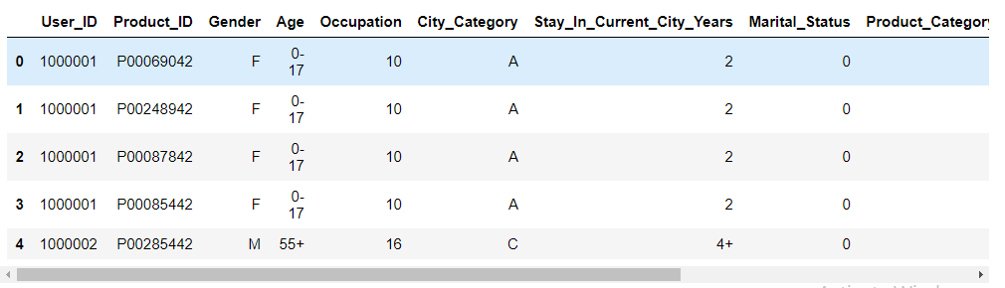

DATA WRANGLING
head() : Pandas head() method is used to return top n (5 by default) rows of a data frame or series.
1
2

Slide 7
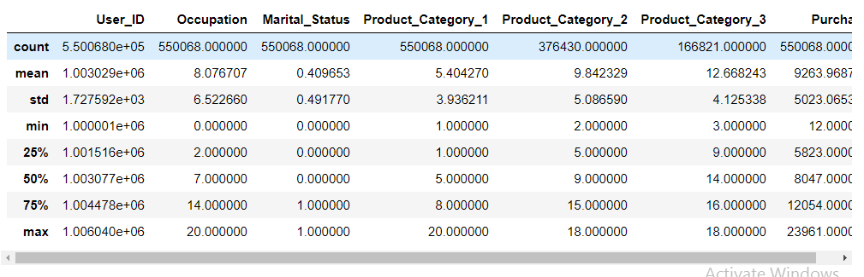

DATA WRANGLING
describe() : Pandas describe() is used to view some basic statistical details like percentile, mean, std etc. of a data frame or a series of numeric values.
1
2

Slide 8
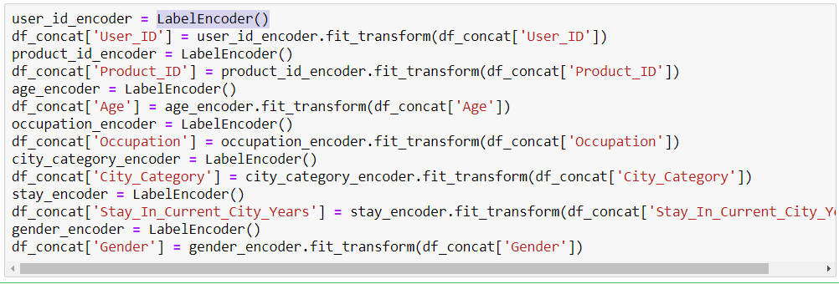
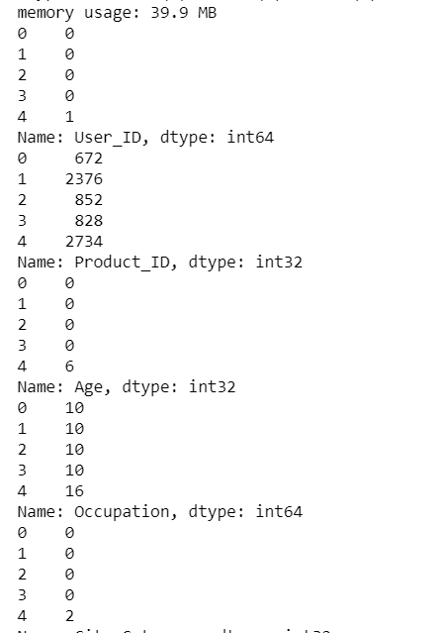
DATA WRANGLING
LabelEncoder(): Label Encoding refers to converting the labels into numeric form so as to convert it into the machine-readable form. Machine learning algorithms can then decide in a better way on how those labels must be operated. It is an important pre-processing step for the structured dataset in supervised learning.
1
2

Slide 9
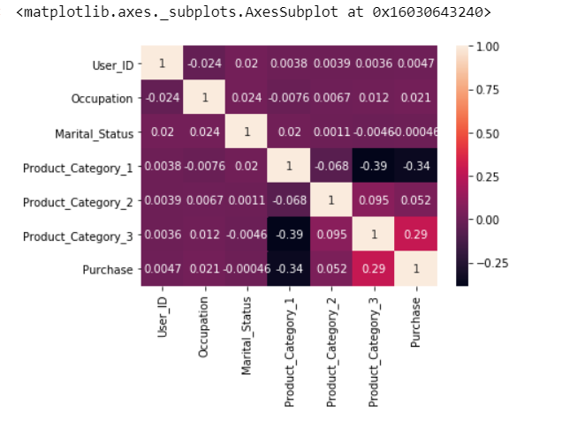
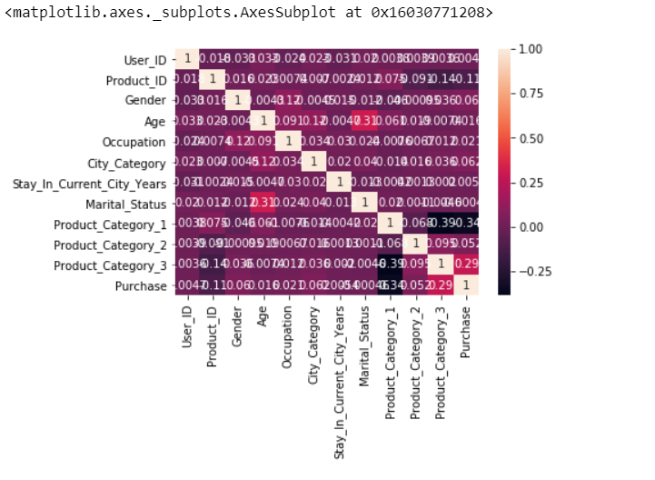
DATA WRANGLING
CORRELATION COEFFICIENT :
The correlation coefficient is a statistical measure that calculates the strength of the relationship between the relative movements of two variables. The values range between -1.0 and 1.0

Slide 10
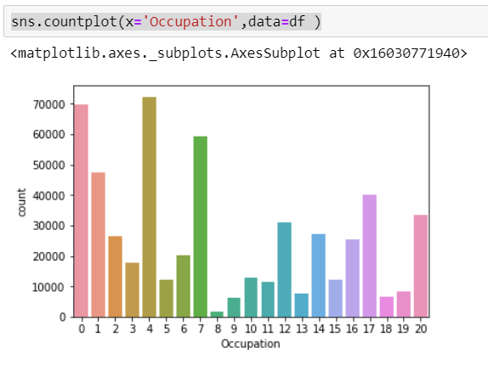
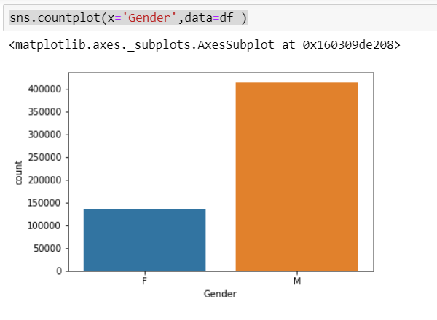
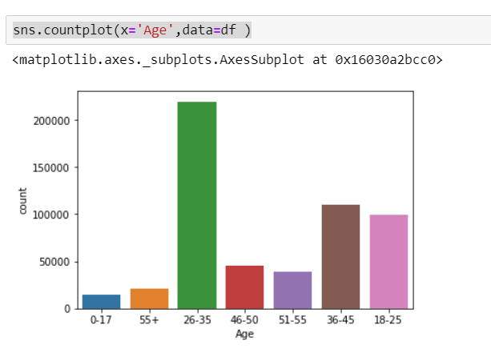
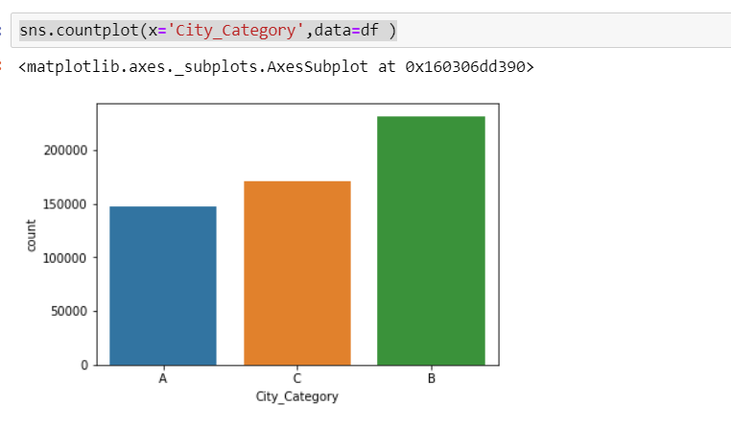
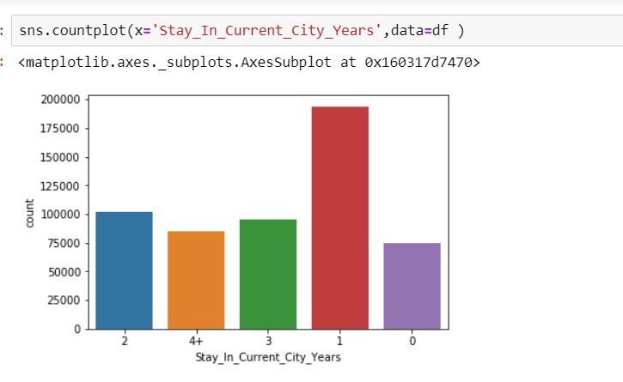
DATA WRANGLING

Slide 11
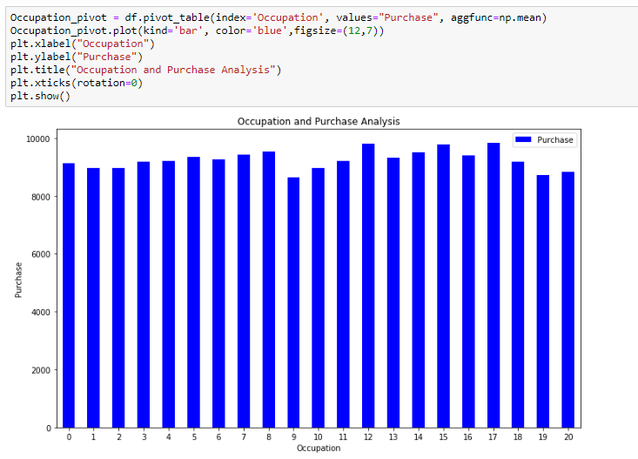
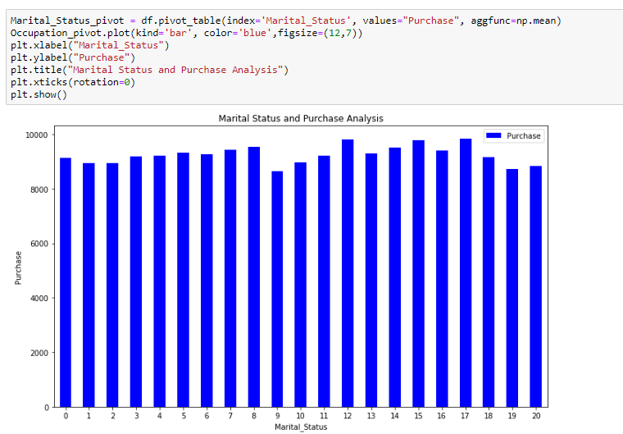
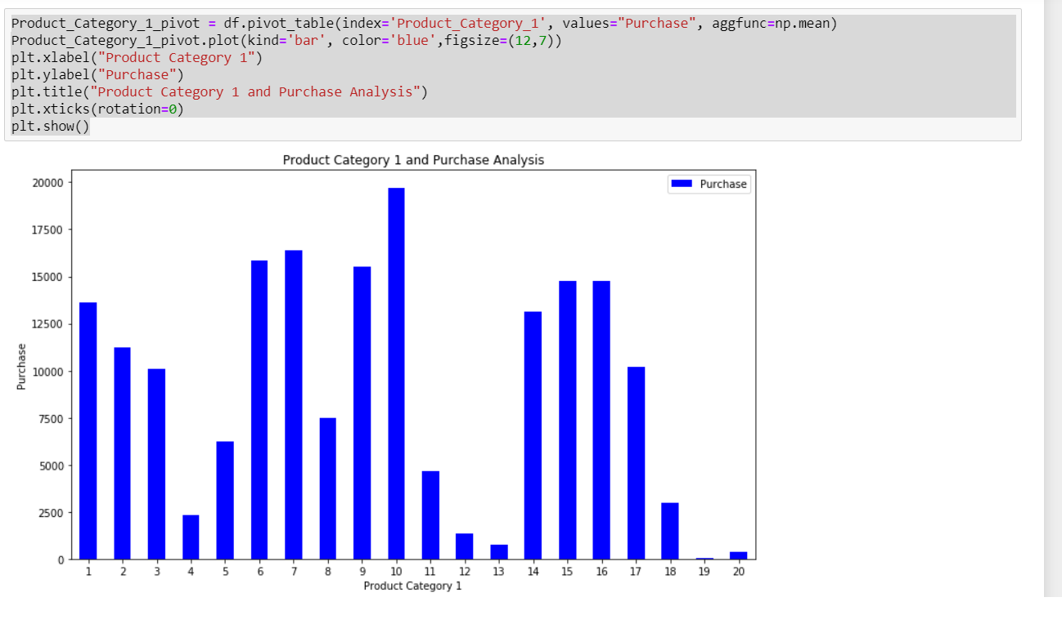
DATA WRANGLING

Slide 12
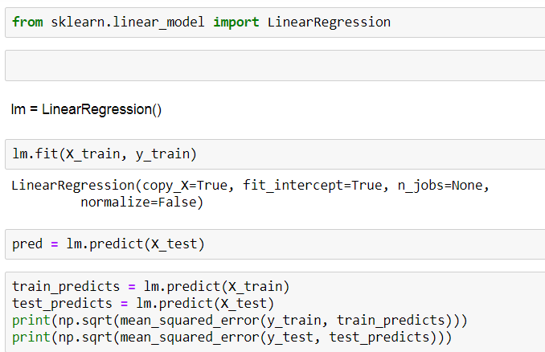

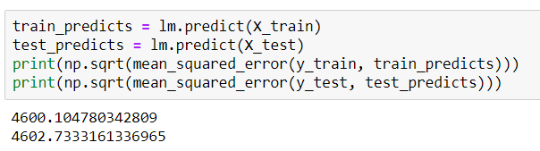
LINEAR
REGRESSION
Linear regression is a statistical approach for modelling relationship between a dependent variable with a given set of independent variables.

Slide 13
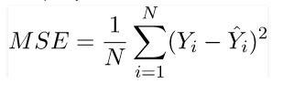
LINEAR
REGRESSION
Mean Squared Error
1
2
The Mean Squared Error of an estimator measures the average of error squares i.e. the average squared difference between the estimated values and true value. It is a risk function, corresponding to the expected value of the squared error loss.
It is always non – negative and values close to zero are better.

Slide 14
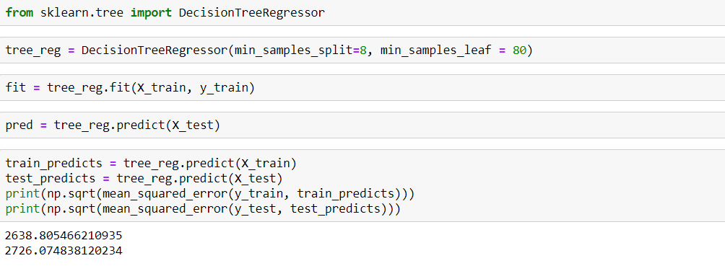
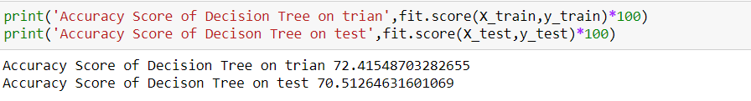
DECISION TREE
A decision tree is a decision support tool that uses a tree-like model of decisions and their possible consequences, including chance event outcomes, resource costs, and utility. It is one way to display an algorithm that only contains conditional control statements.

Slide 15
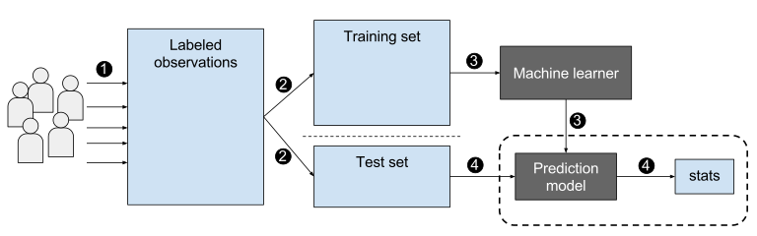
Gradient Boosting
Gradient boosting is a machine learning technique for regression and classification problems, which produces a prediction model in the form of an ensemble of weak prediction models, typically decision trees.

Slide 16
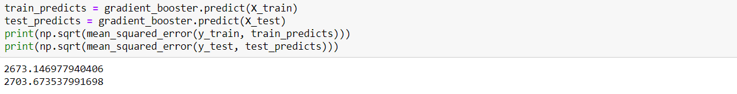
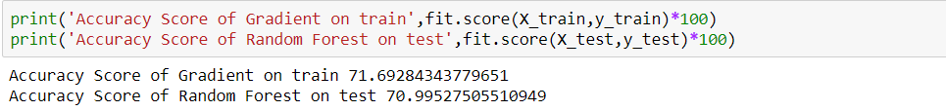
Gradient Boosting

Slide 17


RANDOM FOREST
Random Forest Classifier is an ensemble algorithm, which creates a set of decision trees from a randomly selected subset of the training set, which then aggregates the votes from different decision trees to decide the final class of the test object

Slide 18
OBSERVATIONS
In the whole predictive analysis of Black Friday, we are predicting the customer purchase with respect to the input attributes.
As explained, the graph shows that occupation value 12 purchased more as compared to others, coming to the marital status both single and married people purchased similarly.
Marital status- Surprisingly, Male purchased more compared to the female. Age between the 51-55 bought more products.
People in the city C and people who stayed in a city for 2 years purchased compared to others.
Finally, product 10 in products category 1 and also in product category2. In category 3 product 3 got more purchased.

Slide 19
ACCURACY(CONTD…)
Accuracy checking on train and test data with python results.
Random forest regression acquired better results than the Linear Regression.

Slide 20
CONCLUSION
1
2
We have used Linear regression, Decision Tree, Random Forest and Gradient Boosting to predict the purchase of customers.
After doing the analysis, Random Forest is good for the Black Friday prediction purchase analysis.

Slide 21

THANK YOU!

Slide 22

ANY QUESTIONS ?

